Slide 1
CSC 3210 Computer Organization and Programming
Chapter 12: Floating-Point Processing and Instruction Encoding

Slide 2
Floating-Point Numbers
Programming languages support numbers with fraction
Called floating-point numbers
Examples:
3.14159265… (π)
2.71828… (e)
Scientific form: 26.6
26.6 X 10⁴
= 266000
26.6 X 10⁻¹
= 2.66
The point floating around based on the exponent value
26.6 X 10⁻²
= 0.267
We have to choose one form.

Slide 3
Floating-Point Numbers
We use a Normal scientific notation to represent
Very small numbers (e.g. 1.0 × 10⁻⁹)
Very large numbers (e.g. 8.64 × 10¹³)
Normal Scientific notation for Decimal: ± d. f₁f₂f₃f₄ … × 10 ^{± e1e2e3}
3.14 = 3.14 X 10⁰
366.99 is not in a Normal Scientific notation?
3.6699 X 10²
0.36699 is not in a Normal Scientific notation?
3. 6699 X 10⁻¹
How about 0.0063?

Slide 5
Floating-Point Numbers
Normal Scientific notation for binary: ± b. f₁f₂f₃f₄ … × 2 ^{± (e1e2e3)}2
Example: 101.11
How to convert 1.0111 into decimal?
How to store this number into a computer hardware?
101.11 (convert into normal scientific form)
1.0111 X 2¹⁰

Slide 6
Floating-Point Numbers
Normal Scientific notation for binary: ± b. f₁f₂f₃f₄ … × 2 ^{± (e1e2e3)}2
How to store 1.0111 X 2¹⁰ into a computer hardware?
1.0111 X 2¹⁰
0 | 0 | 1 | 0 | 0 | 1 | 1 | 1
Sign
Exponent
Fraction

Slide 7
Floating-Point Numbers
How about storing 0.1 (0.1 X 2⁰) ?
1.0 X 2⁻¹
convert into normal scientific form
We don’t store the 1 before the . ? 0000
How to store the negative exponent (-1)?
No 2’com, then how?
Use biasing method? 2^{n-1} - 1, where n is the number of exponents bits
2³⁻¹ -1 = 4 - 1 = 3 (this is called biased/mantissa)
-1 + 3 = 2 010
Convert to binary and store the binary
0 | 0 | 1 | 0 | 0 | 0 | 0 | 0
Sign
Exponent
Fraction

Slide 8
Floating-Point Binary Representation
CONVERT A floating-point to a binary:
0 | 0 | 1 | 0 | 0 | 0 | 1 | 0

Slide 9
Floating-Point Binary Representation
A floating-point to a binary:
0 | 0 | 1 | 0 | 0 | 0 | 1 | 0
0.5625
Sign = 0 (+)
Exponent = saved Exponent – 3
Fraction = 0010
(-1)^{s} X (1.Signficant)₂ X 2^{E-3}
(-1)⁰ X 1.001 X 2⁻¹
1 X 1.001 X 0.1 = .1001
To decimal:
1 X 1.125 X 0.5 = 0.5625
Notes:
Saved expoenent is 2 and when we 2-3=-1

Slide 10
Outline
Floating-Point Binary Representation
Floating-Point Unit
x86 Instruction Encoding

Slide 11
Floating-Point Binary Representation
There are two fundamental types of microprocessor instructions:
integer and floating-point.
Accordingly, they are executed
On an Integer Processing Unit and
On a Floating-Point Processing Unit.
But what tells the processor to send an instruction to IPU or FPU?
How does it know which instruction is which kind?
Maybe an instruction have a bit / flag / LUT or something to differentiate one from another?

Slide 12
Floating-Point Binary Representation
Each CPU instruction has an opcode.
The CPU looks at the opcode to determine which execution unit the instruction should be dispatched to.
For floating point instructions on x86 the opcode typically starts with:
1101 1.... i.e.
the first hex digit is D
and then the MS bit of the next digit is set.

Slide 13
Floating-Point Binary Representation
A floating-point number is represented by the triple:
S is the Sign bit (0 is positive and 1 is negative)
Representation is called sign and magnitude
E is the Exponent field (signed)
Very large numbers have large positive exponents
Very small close-to-zero numbers have negative exponents
More bits in exponent field increases range of values
F is the Fraction field (fraction after binary point)
More bits in fraction field improves the precision of FP numbers

Slide 15
Floating-Point Binary Representation
IEEE Floating-Point Binary Reals
The Exponent
Normalized Binary Floating-Point Numbers
Creating the IEEE Representation
Converting Decimal Fractions to Binary Reals

Slide 16
IEEE Floating-Point Binary Reals
Types
Single Precision
32 bits: 1 bit for the sign, 8 bits for the exponent, and 23 bits for the fractional part of the significand.
Double Precision
64 bits: 1 bit for the sign, 11 bits for the exponent, and 52 bits for the fractional part of the significand.
Double Extended Precision
80 bits: 1 bit for the sign, 16 bits for the exponent, and 63 bits for the fractional part of the significand.
S | Exponent¹⁶ | Fraction⁶³

Slide 17
Single-Precision Format
Approximate normalized range: –126 to 127.
Also called a short real.

Slide 18
Components of a Single-Precision Real
Sign
1 = negative, 0 = positive
Significand
decimal digits to the left & right of decimal point
weighted positional notation
Example:
123.154 = (1 x 10²) + (2 x 10¹) + (3 x 10⁰) + (1 x 10^{–1}) + (5 x 10^{–2}) + (4 x 10^{–3})
Exponent
unsigned integer
integer bias (127 for single precision)
Notes:
Tue, 4pm, Nov 14

Slide 19
Components of a Single-Precision Real
Binary floating-point numbers also use weighted positional notation.
The floating-point binary value 11.1011 is expressed as
0.6875

Slide 20
Components of a Single-Precision Real

Slide 21
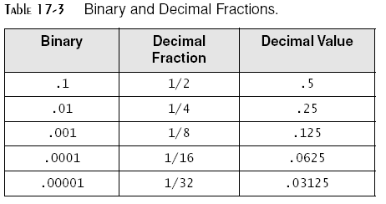
Components of a Single-Precision Real

Slide 22
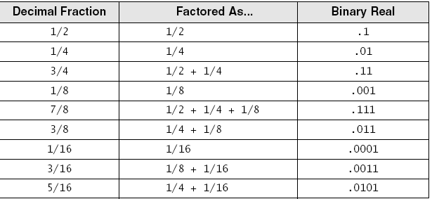
Converting Fractions to Binary Reals
Express as a sum of fractions having denominators that are powers of 2
Examples:

Slide 23
The Exponent
The exponent range is from -126 to 127 (in Single-Precision)
Sample Exponents represented in Binary
Add 127 to actual exponent to produce the biased exponent

Slide 24
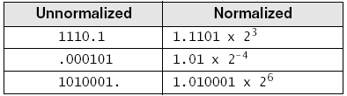
Normalizing Binary Floating-Point Numbers
Mantissa is normalized when a single 1 appears to the left of the binary point
Unnormalized: shift binary point until exponent is zero
Examples
Notes:
Wed 3pm, Nov 13

Slide 25
Real-Number Encodings
Normalized finite numbers
all the nonzero finite values that can be encoded in a normalized real number between zero and infinity
Example:
binary 1.101 X 2⁰ is represented as follows:
0 + 127
23 bits: 10100000000000000000000
0 01111111 10100000000000000000000
Notes:
Tue, 9:30, Nov14
convert into normal scientific form
We don’t store the 1 before the . ? 0000
How to store the negative exponent (-2)?
No 2’com, then how?
Use biasing method? 2^{n-1} - 1, where n is the number of exponents bits
2³⁻¹ -1 = 4 - 1 = 3 (this is called biased/mantissa)
-1 + 3 = 2 010
Convert to binary and store the binary

Slide 26
Real-Number Encodings
Example:

Slide 27
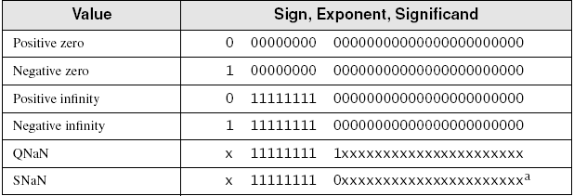
Real-Number Encodings
Specific encodings (single precision):
ª SNaN significand field begins with 0, but at least one of the remaining bits must be 1.
x can be either 1 or 0 (DO NOT CARE)

Slide 28
Converting Single-Precision to Decimal
1. If the MSB is 1, the number is negative; otherwise, it is positive.
2. The next 8 bits represent the exponent.
Subtract binary 01111111 (decimal 127), producing the unbiased exponent.
Convert the unbiased exponent to decimal.

Slide 29
Converting Single-Precision to Decimal
3. The next 23 bits represent the significand.
Notate a “1.”, followed by the significand bits.
Trailing zeros can be ignored.
Create a floating-point binary number,
using the significand,
the sign determined in step 1,
and the exponent calculated in step 2.

Slide 30
Converting Single-Precision to Decimal
4. Unnormalize the binary number produced in step 3.
Shift the binary point the number of places equal to the value of the exponent.
Shift right if the exponent is positive, or left if the exponent is negative.
5. From left to right,
use weighted positional notation to form the decimal sum of the powers of 2 represented by the floating-point binary number.

Slide 31
Example1
Convert 01000001001011000000000000000000 to Decimal
1. The number is positive.
2. The unbiased exponent is binary 00000011, or decimal 3 (130 (10000010) – 127 (01111111) = 3).
3. Combining the sign, exponent, and significand, the binary number is +1.01011 X 2³.
4. The unnormalized binary number is +1010.11
5. The decimal value is +10 3/4, or +10.75.

Slide 32
Example2
Convert - 19.3 to IEEE Floating-Point Binary Representation
1. Convert - 19.3 into binary
2. Normalize the converted binary
3. Find the exponent and store it (add it to the Biased)
4. Write the normalized number in IEEE format
Sign Exponent Fraction
?
?
?

Slide 33
Outline
Floating-Point Binary Representation
Floating-Point Unit
x86 Instruction Encoding

Slide 34
Floating Point Unit
FPU Register Stack
Rounding
Floating-Point Exceptions
Floating-Point Instruction Set
Arithmetic Instructions
Mixed-Mode Arithmetic
Comparing Floating-Point Values
Reading and Writing Floating-Point Values

Slide 35
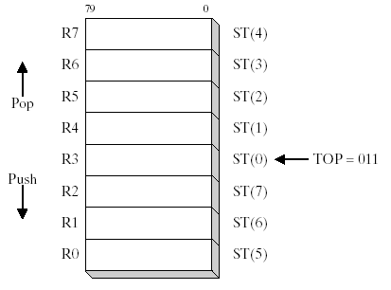
FPU Register Stack
The FPU does not use the general-purpose registers (EAX, EBX, etc.).
Instead, it has its own set of registers called a register stack.
Eight individually addressable 80-bit data registers
named R0 through R7
Three-bit field named TOP in the FPU status word identifies
The register number that is currently the top of stack.

Slide 36
FPU Register Stack
FPU:
Loads values from memory into the register stack,
Performs calculations, and
Stores stack values into memory
FPU instructions evaluate mathematical expressions in postfix format
- infix expression: (5 * 6) - 4
- postfix equivalent is: 5 6 * 4 -

Slide 38
FPU Register Stack
Translating infix expressions to postfix
Notes:
(A+B) * (C-D)

Slide 39
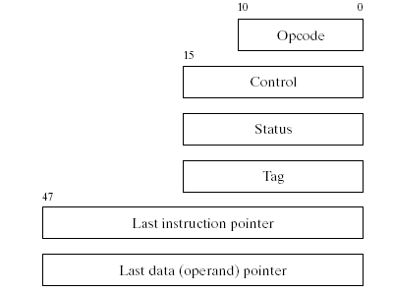
Special-Purpose Registers
Notes:
TH, Nov 16, 9:30

Slide 40
Floating Point Unit
FPU Register Stack
Rounding
Floating-Point Exceptions
Floating-Point Instruction Set
Arithmetic Instructions
Mixed-Mode Arithmetic
Comparing Floating-Point Values
Reading and Writing Floating-Point Values
Notes:
Wed, Nov,15, 3pm

Slide 41
Rounding
FPU attempts to round an infinitely accurate result from a floating-point calculation
may be impossible because of storage limitations
Example
suppose 3 fractional bits can be stored, and a calculated value equals +1.0111.
rounding up by adding .0001 produces 1.100
rounding down by subtracting .0001 produces 1.011

Slide 42
Rounding
Examples

Slide 43
Floating Point Unit
FPU Register Stack
Rounding
Floating-Point Exceptions
Floating-Point Instruction Set
Arithmetic Instructions
Mixed-Mode Arithmetic
Comparing Floating-Point Values
Reading and Writing Floating-Point Values

Slide 44
Floating-Point Exceptions
Six types of exception conditions
Invalid operation
Divide by zero
Denormalized operand
Numeric overflow
Numeric underflow
Inexact precision
Each has a corresponding mask bit
if set when an exception occurs, the exception is handled automatically by FPU
if clear when an exception occurs, a software exception handler is invoked

Slide 45
Floating Point Unit
FPU Register Stack
Rounding
Floating-Point Exceptions
Floating-Point Instruction Set
Arithmetic Instructions
Mixed-Mode Arithmetic
Comparing Floating-Point Values
Reading and Writing Floating-Point Values

Slide 46
FPU Instruction Set
Instruction mnemonics begin with letter F
Second letter identifies data type of memory operand
FLBD load binary coded decimal: B = bcd
FISTP store integer and pop stack: I = integer
FMUL multiply floating-point operands no letter: floating point

Slide 47
FPU Instruction Set
Operands
zero, one, or two
no immediate operands
no general-purpose registers (EAX, EBX, ...)
integers must be (before being used in calculations)
loaded from memory onto the stack and
converted to floating-point
if an instruction has two operands,
one must be a FPU register
Notes:
Thu, 4pm, Nov 16

Slide 48
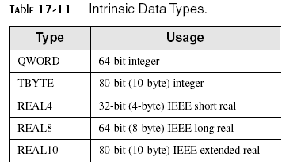
FPU Instruction Set
Data Types

Slide 49
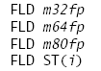
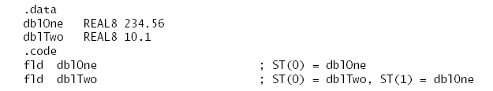
Load Floating-Point Value
FLD
copies floating point operand from memory into the top of the FPU stack, ST(0)
Example
i is a register number
FPU stack

Slide 50
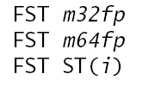
Store Floating-Point Value
FST
copies floating point operand from the top of the FPU stack into memory
does not pop the top of the stack
Example:
Assume ST(0) equals 10.1 and ST(1) equals 234.56:
FPU stack
fst dblThree ; 10.1
fst dblFour ; 10.1
expected dblFour to equal 234.56

Slide 51
Store Floating-Point Value
FSTP (copies floating point operand from the top of the FPU stack into memory)
pops the stack after copying
Example:
Assume ST(0) equals 10.1 and ST(1) equals 234.56:
fstp dblThree ; 10.1
fstp dblFour ; 234.56

Slide 52
Floating Point Unit
FPU Register Stack
Rounding
Floating-Point Exceptions
Floating-Point Instruction Set
Arithmetic Instructions
Mixed-Mode Arithmetic
Comparing Floating-Point Values
Reading and Writing Floating-Point Values

Slide 53
Arithmetic Instructions
Same operand types as FLD and FST

Slide 54
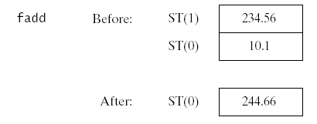
Floating-Point Add
FADD
adds source to destination
No-operand version pops the FPU stack after adding
Example:
i is a register number
Destination is always FPU Register
Notes:
Destination is always FPU Register

Slide 55
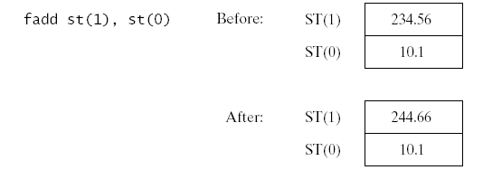
Floating-Point Add
FADD
adds source to destination
Register Operands
Example:
Destination is always FPU Register

Slide 56
Floating-Point Add
FADD
adds source to destination
Memory Operands: FADD adds the operand to ST(0).
Example:
Destination is always FPU Register

Slide 57
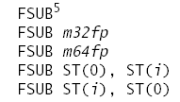
Floating-Point Subtract
FSUB
subtracts source from destination.
No-operand version pops the FPU stack after subtracting
Example:
Destination is always FPU Register

Slide 58
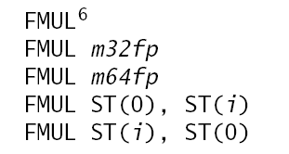
Floating-Point Multiply
FMUL
Multiplies source by destination, stores product in destination
The no-operand versions of FMUL and FDIV pop the stack after multiplying or dividing.
Destination is always FPU Register

Slide 59
Example for: Fld, Fstp Fadd, Fsub, fmul
E = (A + B) * (C - D)
A=1.9, B=2.1, C=5.3, D=0.3, E=?

Slide 60

Floating-Point Divide
FDIV
Divides destination by source, then pops the stack
The no-operand versions of FMUL and FDIV pop the stack after multiplying or dividing.
Destination is always FPU Register

Slide 61
FPU Code Example
.data
valA REAL8 1.5
valB REAL8 2.5
valC REAL8 3.0
valD REAL8 ? ; will be +6.0
.code
fld valA ; ST(0) = valA
fchs ; change sign of ST(0)
fld valB ; load valB into ST(0)
fmul valC ; ST(0) *= valC
fadd ; ST(0) += ST(1)
fstp valD ; store ST(0) to valD
valD = –valA + (valB * valC).

